Slide 1

Python 101

Slide 2
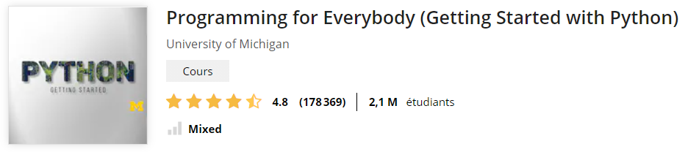
Plan
Datatypes (numerics, string, list, dict)
Loops , Conditions, Functions
Import/export data from files

Slide 3
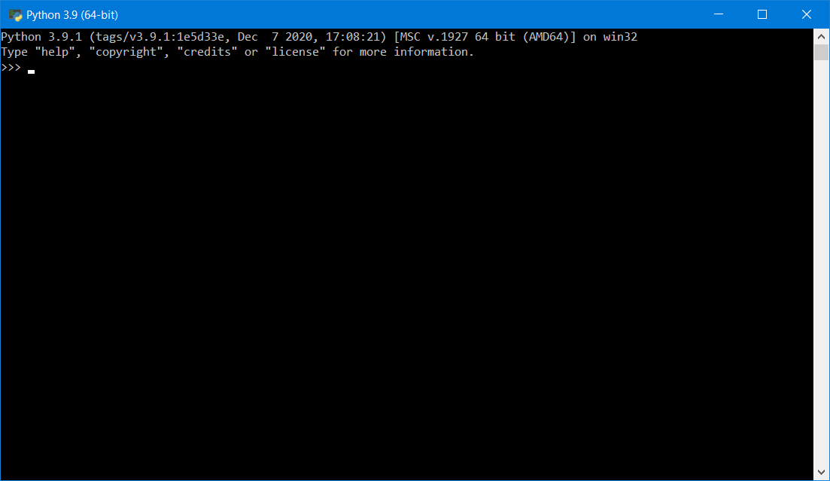
First steps with the prompt

Slide 4
1. Datatypes
Integer
Float
String
List
Dict
More advanced datatypes:
Array
Dataframe
…

Slide 5

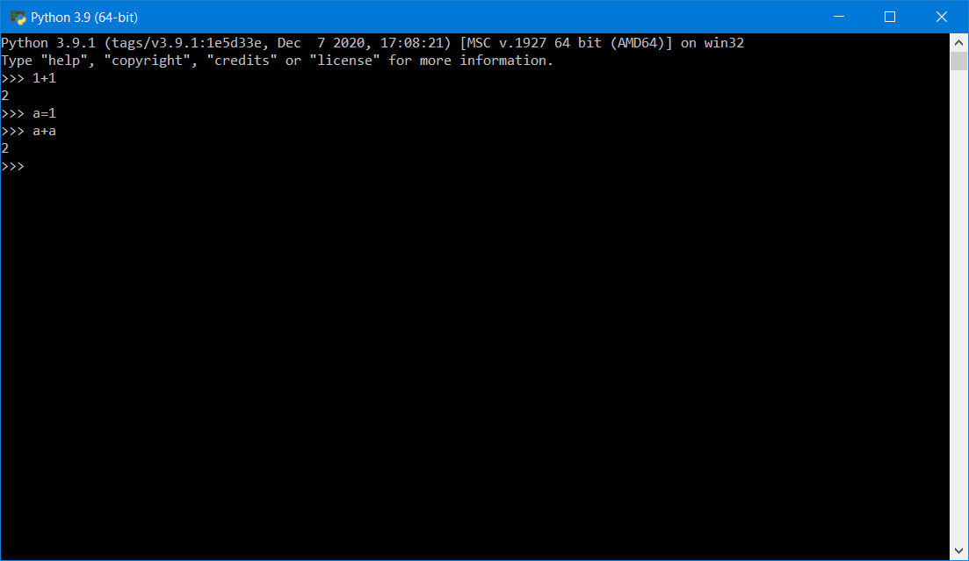
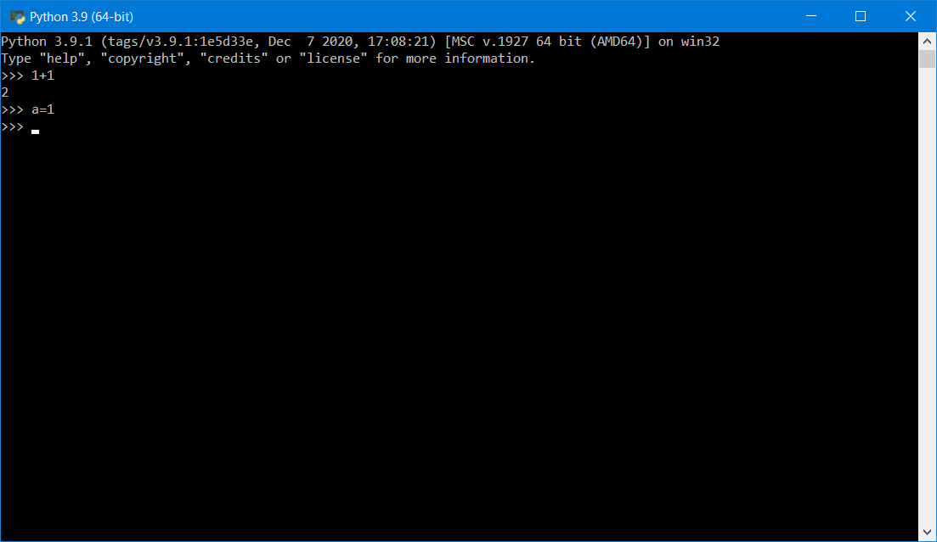
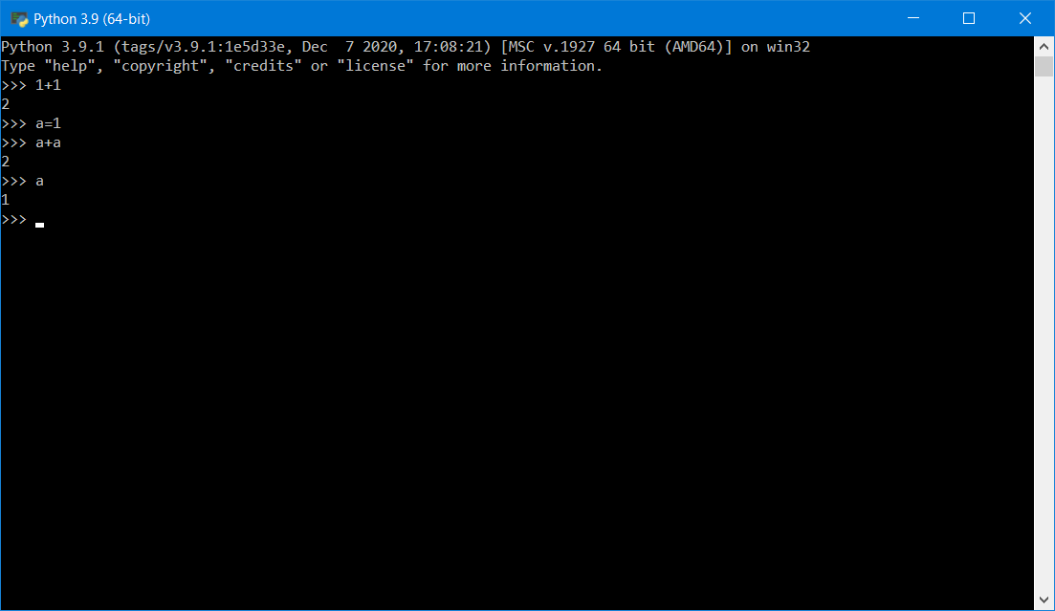
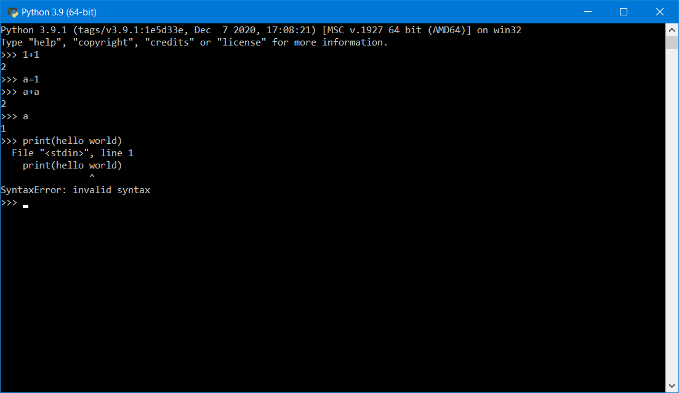
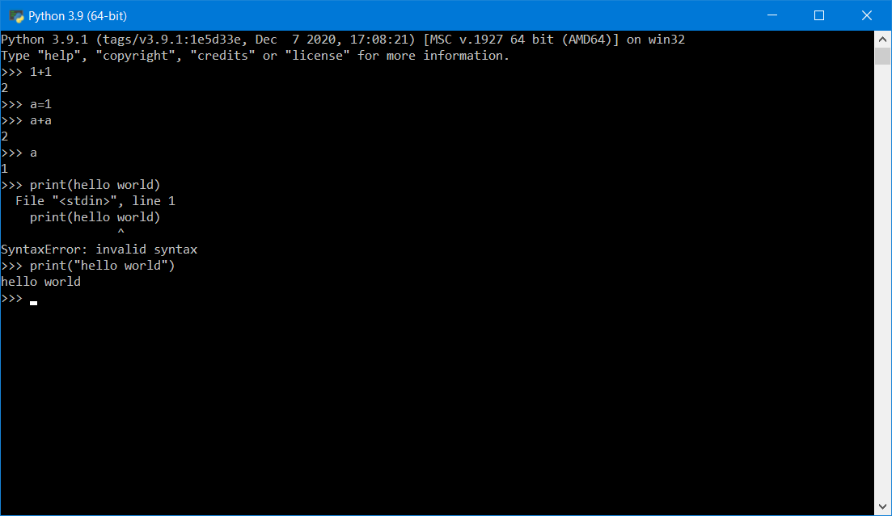
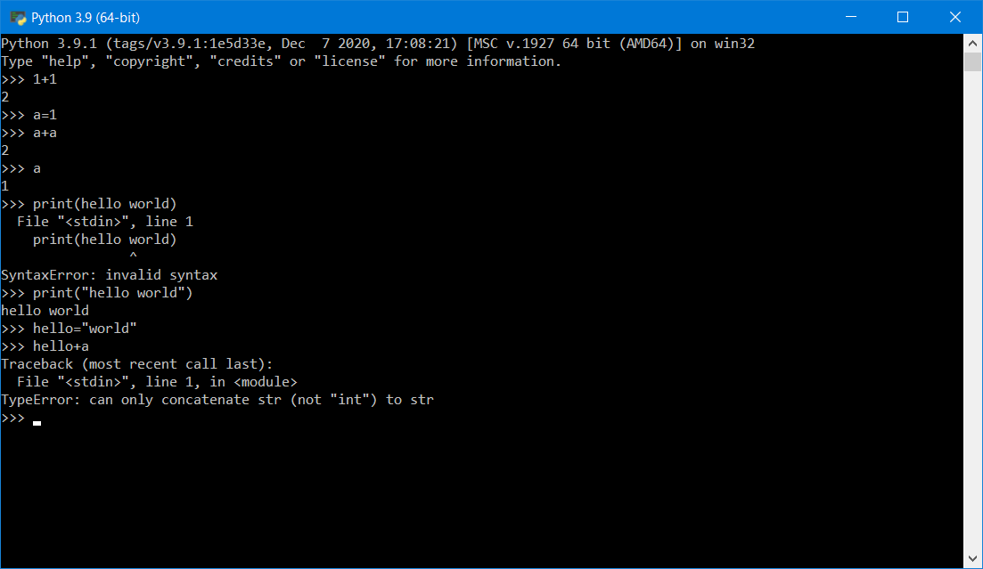
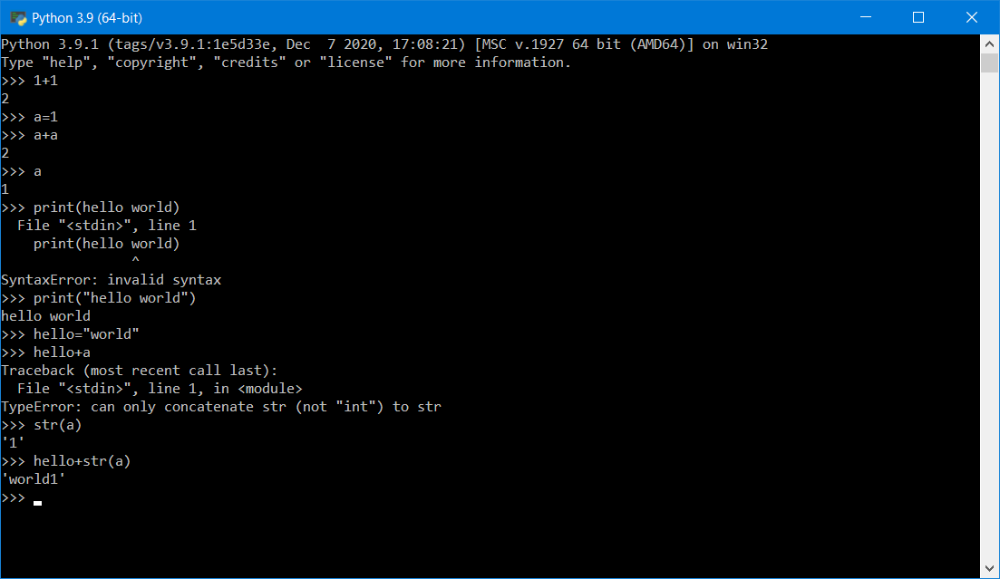

Slide 6
More on Strings
6.1: A string is a sequence
6.2: Getting the length of a string using len
6.3: Traversal through a string with a loop
6.4: String Slices
6.5: Strings are immutable
6.6: Looping and Counting
6.7: The in operator
6.8: String Comparison
6.9: String Methods
6.E: Strings (Exercises)
6.G: Strings (Glossary)
6.10: Parsing strings
6.11: Format operator
6.12: Debugging
Python for Everybody – Chap 6 Strings
PY4E – HTML

Slide 7
2. Loops , Conditions, Functions
Loops
Conditions
Functions
Write your first program (in Notepad)

Slide 8
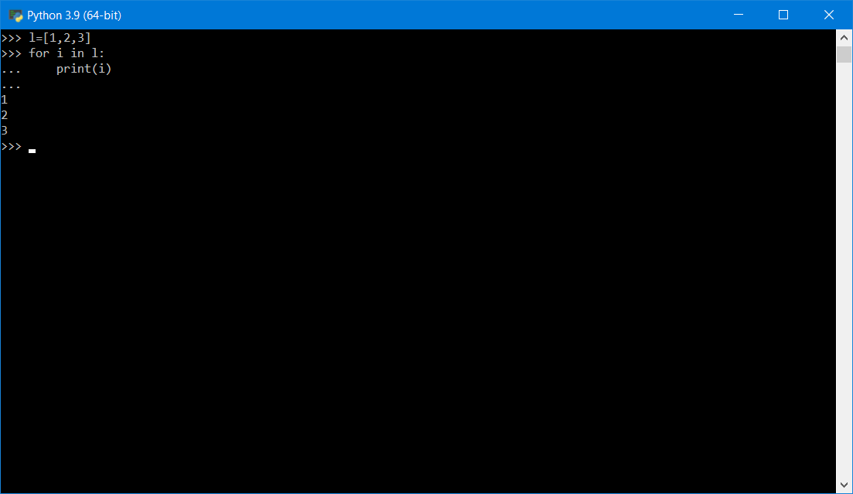

Slide 9
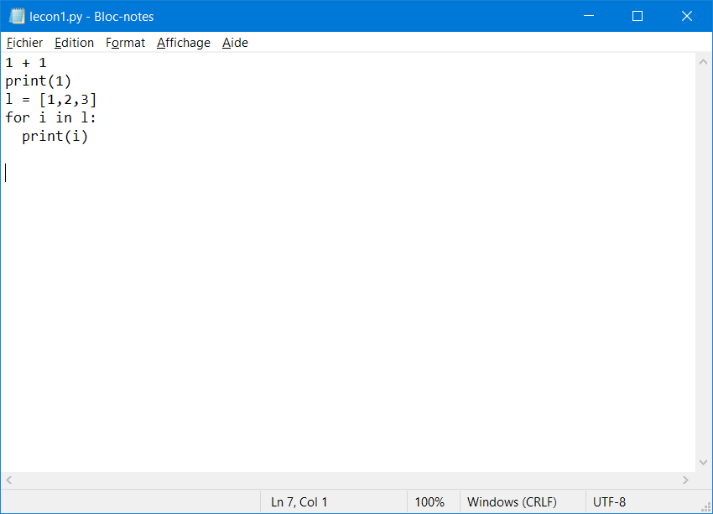

Slide 10
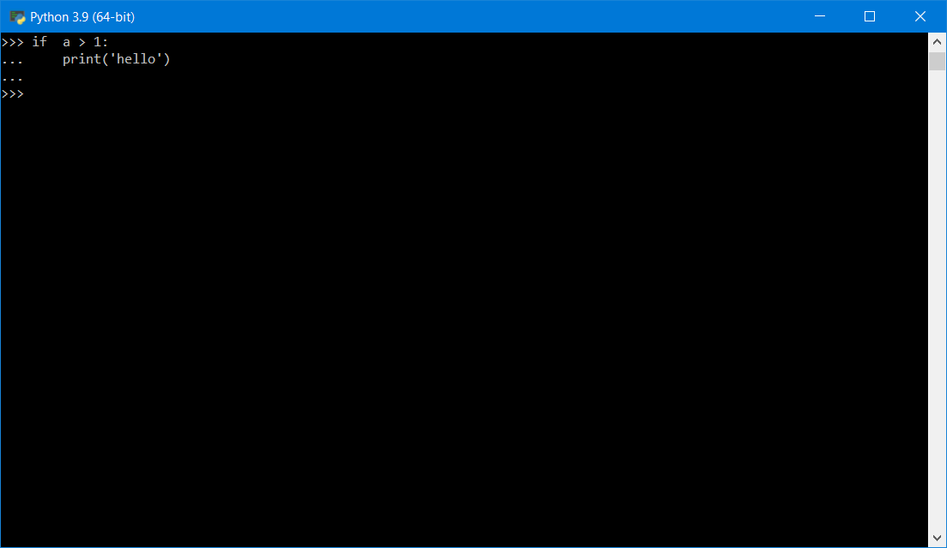

Slide 11
More on Lists
8.1: A list is a sequence
8.2: Lists are mutable
8.3: Traversing a List
8.4: List operations
8.5: List Slices
8.6: List Methods
8.7: Deleting Elements
8.8: Lists and Functions
8.9: Lists and Strings
8.E: Lists (Exercises)
8.G: Lists (Glossary)
8.10: Parsing lines
8.11: Objects and Values
8.12: Aliasing
8.13: List arguments
8.14: Debugging
PY4E - HTML
Python for Everybody - Chap 8 Lists

Slide 12
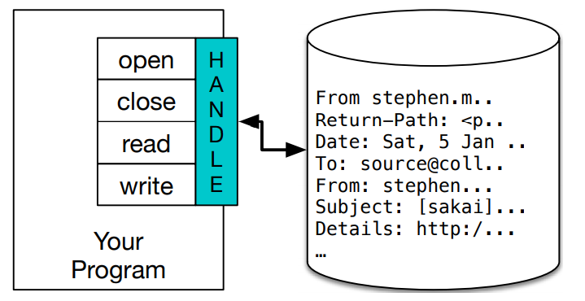
3. Import/export data from files
>>> fhand = open('mbox.txt’)
>>> print(fhand)
<_io.TextIOWrapper name='mbox.txt' mode='r' encoding='cp1252'>
Python for Everybody – Chap 7 Files

Slide 13
Reading files
fhand = open('mbox-short.txt’)
count = 0
for line in fhand:
count = count + 1
print('Line Count:', count)
https://www.py4e.com/code3/mbox.txt

Slide 14
Writing files
>>> fout = open('output.txt', 'w’)
>>> line1 = "This here's the wattle,\n“
>>> fout.write(line1)
>>> line2 = 'the emblem of our land.\n’
>>> fout.write(line2)
>>> fout.close()

Slide 15
More on Files
7.1: Persistence
7.2: Opening Files
7.3: Text files and Lines
7.4: Reading Files
7.5: Searching through a File
7.6: Letting the user choose the file name
7.7: Using try, except, and open
7.8: Writing Files
7.9: Debugging
7.E: Files (Exercises)
7.G: Files (Glossary)
Python for Everybody – Chap 7 Files

Slide 16
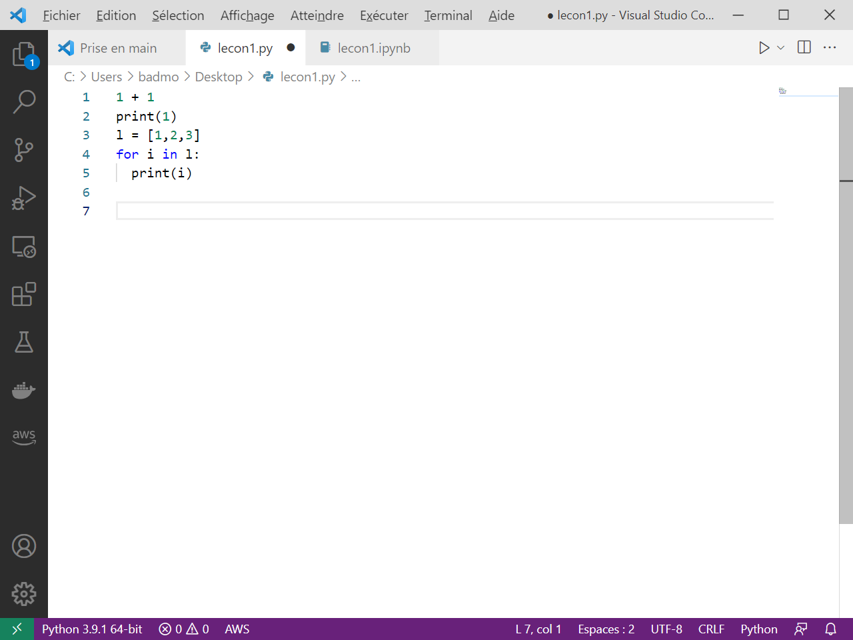
Visual Studio Code Recommended editor for Python
https://code.visualstudio.com/

Slide 17
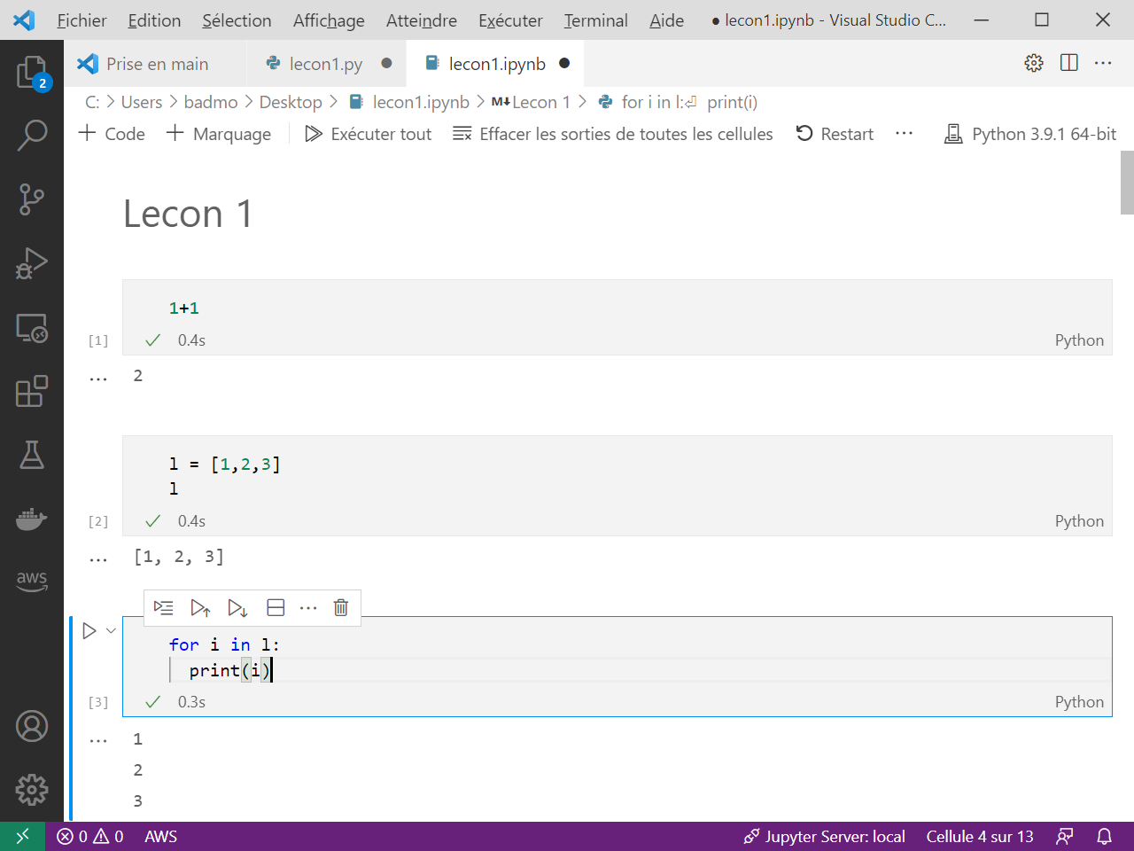
Notebook format for interactivity

Slide 18
Next…
Plotting
Manage packages, Notebooks & Environments

Slide 19
Exercises

Slide 20
Immo.py
Call a function price, that will return the price of real estate in Paris as a dictionary
Get a list of location (lat,lon) and price
Select only the estate under 500k€
Write a file containing this data
(Bonus: plot the data on a map)

Slide 21
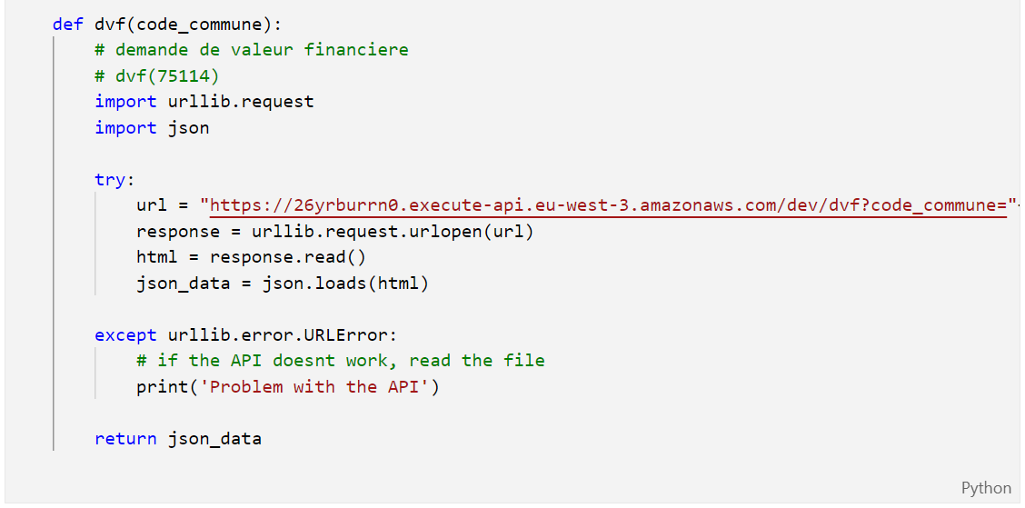
Immo.py
https://gist.github.com/slevin48/05c0d4f348f0f10870a0fa721cfcb1b1

Slide 22
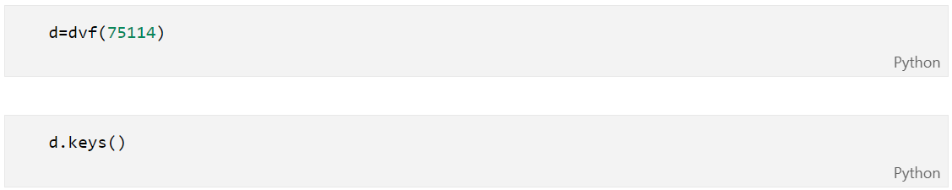
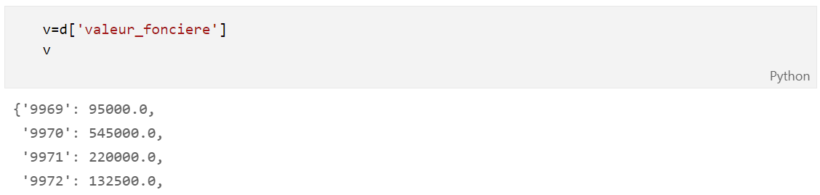
Immo.py

Slide 23
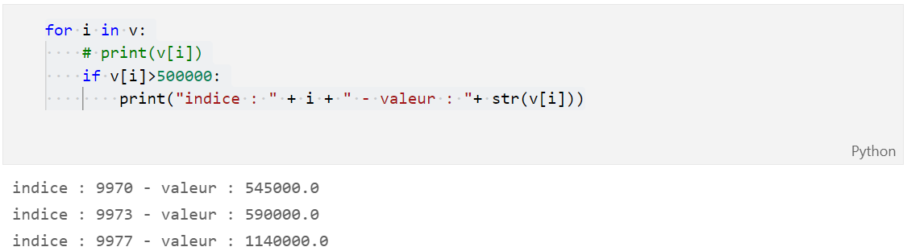
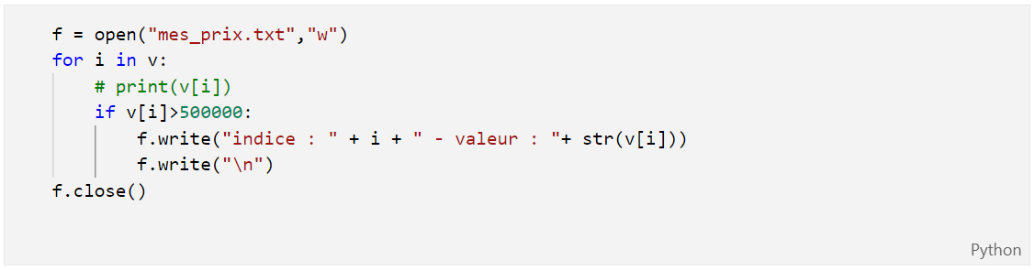
Immo.py

Slide 24

Music.py
Parse Streaming History
Create a dictionary
id
artist name
track name
Music Taste Analysis
Get music features
Plot features
Get recommendation

Slide 25
Music for loop
with open("saved_tracks_20210306.json","r") as f:
results = json.load(f)
tracks = []
for idx, item in enumerate(results['items']):
track = item['track']
tracks.append([idx, track['artists'][0]['name'], track['name']])

Slide 26
Music Dict
trackDict = {"id":[], "artist":[],"name":[]}
for idx, item in enumerate(results['items']):
track = item['track']
trackDict["id"].append(idx)
trackDict["artist"].append(track['artists'][0]['name'])
trackDict["name"].append(track['name'])

Slide 27
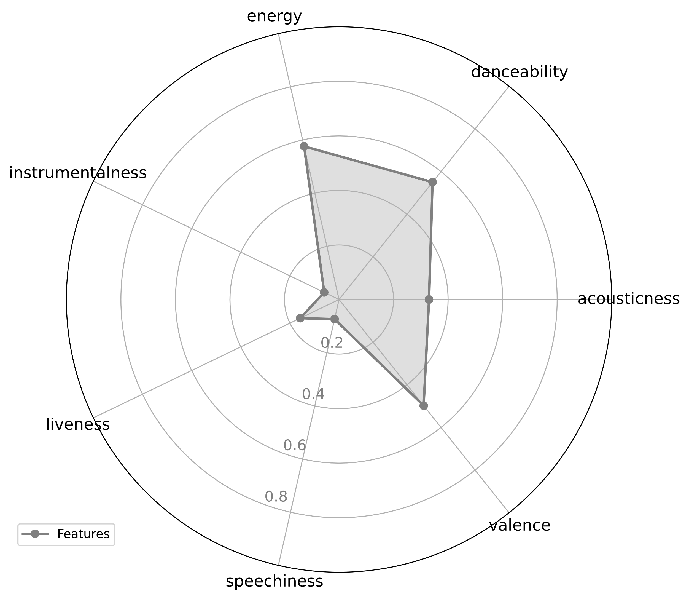
Music taste analysis

Slide 28
Music taste analysis
import spotifyAPI
from secret import clientId,clientSecret token = spotifyAPI.get_token(clientId,clientSecret)
lucy_id = spotifyAPI.get_track_id2('Lucy in the Sky', token, artist = 'The Beatles’)
url = "https://open.spotify.com/track/"+lucy_id
import webbrowser
webbrowser.open(url)

Slide 29
import pandas as pd
lucy_features = spotifyAPI.get_features(lucy_id,token)
df = pd.DataFrame(lucy_features, index=[0])
df_features = df.loc[: ,['acousticness', 'danceability', 'energy', 'instrumentalness', 'liveness', 'speechiness', 'valence’]]
spotifyAPI.feature_plot(df_features)

Slide 30
Music recommendation
json_response = spotifyAPI.get_track_reco(lucy_id,token)
uris =[]
for i in json_response['tracks']:
uris.append(i)
print(f"\"{i['name']}\" by {i['artists'][0]['name']}")

Slide 31

Sources
Data Structures
Using Python to Access Web Data
Using Databases with Python
Capstone: Retrieving, Processing, and Visualizing Data with Python
PY4E - Python for Everybody
Python for Everybody (dr-chuck.com)

Slide 32

Go further
Crash Course on Python | Google
Using Python to Interact with the Operating System
Google IT Automation with Python
Configuration Management and the Cloud
Troubleshooting and Debugging Techniques
Introduction to Git and GitHub | Google
Automating Real-World Tasks with Python | Google

Slide 33

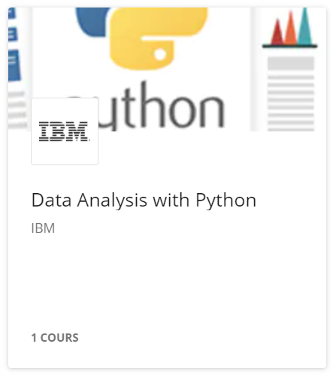
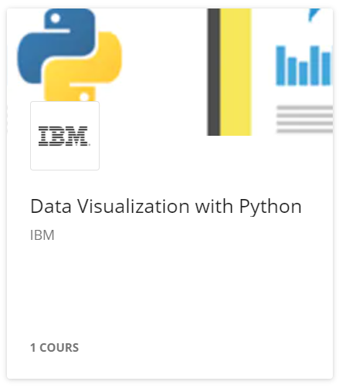

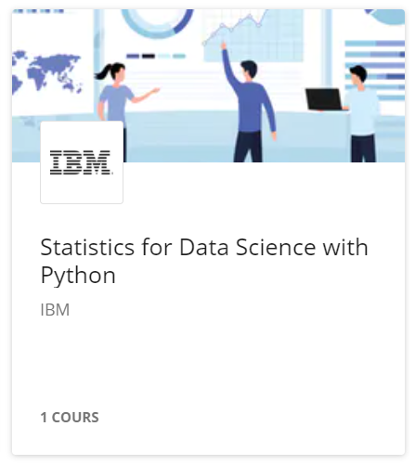
Data Science

Slide 34
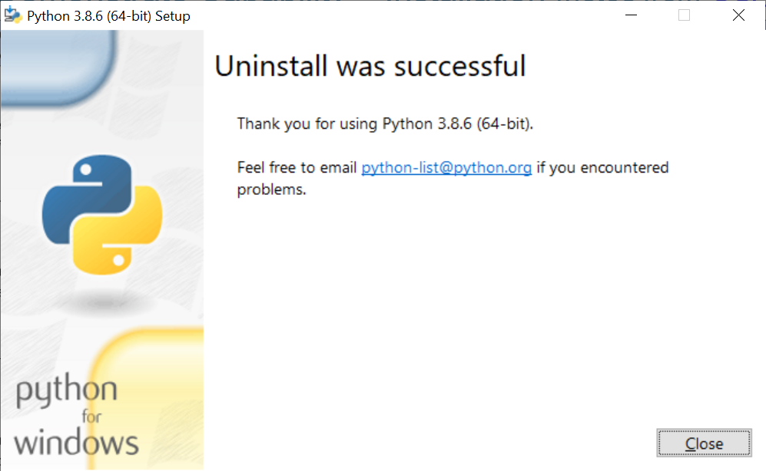
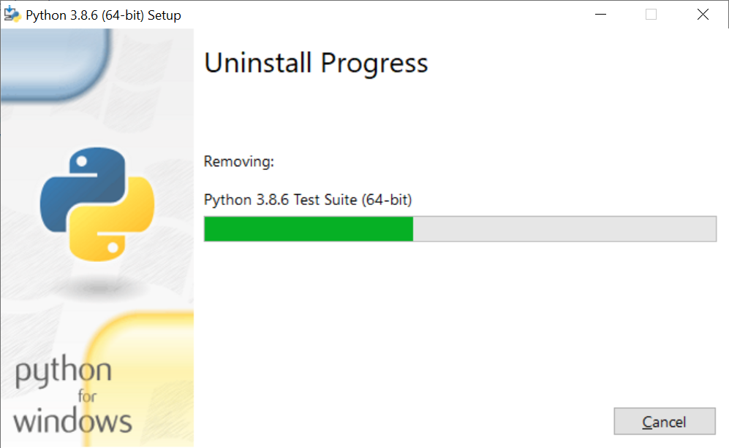
Uninstall Python

